Slide 1
Class Templates array and vector; Catching Exceptions
Chapter 7 of C++ How to Program, 10/e

Slide 2
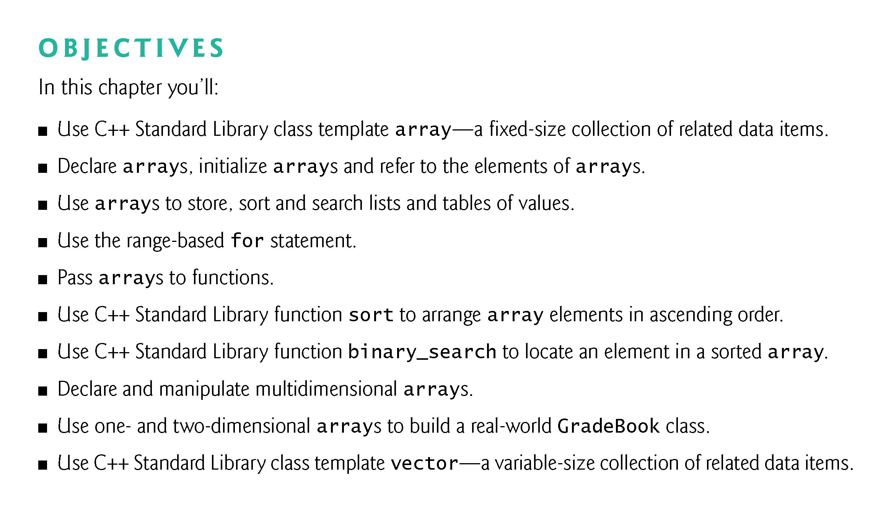

Slide 3
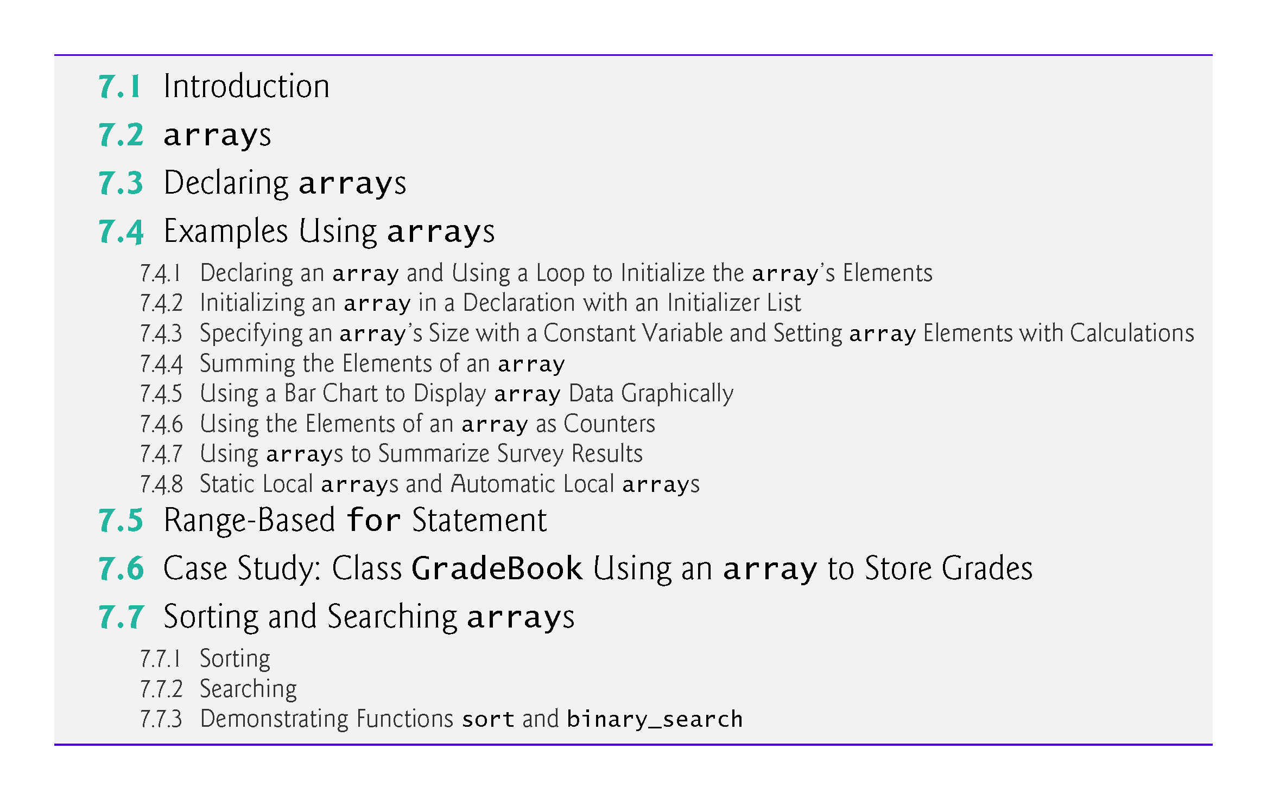

Slide 4
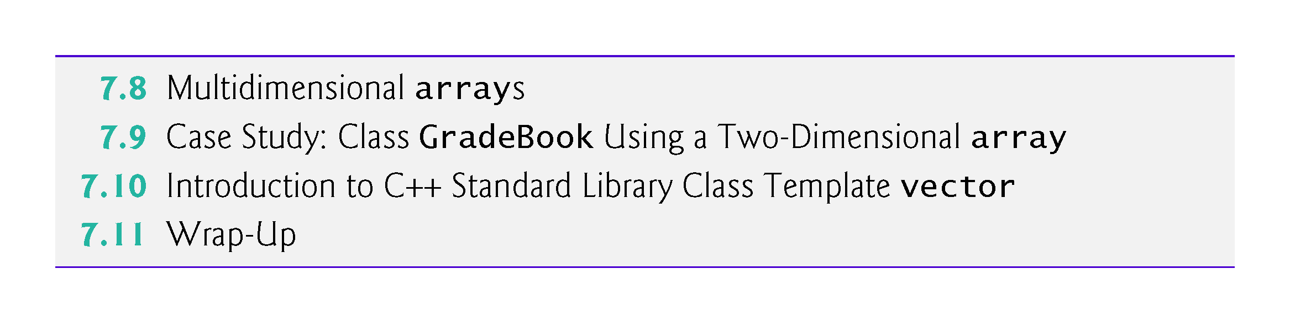

Slide 5
7.1 Introduction
This chapter introduces the topic of data structures—collections of related data items.
We discuss arrays which are fixed-size collections consisting of data items of the same type, and vectors which are collections (also of data items of the same type) that can grow and shrink dynamically at execution time.
Both array and vector are C++ standard library class templates.
We present examples that demonstrate several common array manipulations and introduce exception handling.

Slide 6
7.2 arrays
An array is a contiguous group of memory locations that all have the same type.
To refer to a particular location or element in the array, specify the name of the array and the position number of the particular element.
Figure 7.1 shows an integer array called c.
12 elements.
The position number is more formally called a subscript or index (this number specifies the number of elements from the beginning of the array).
The first element in every array has subscript 0 (zero) and is sometimes called the zeroth element.
The highest subscript in array c is 11, which is 1 less than the number of elements in the array (12).
A subscript must be an integer or integer expression (using any integral type).

Slide 7
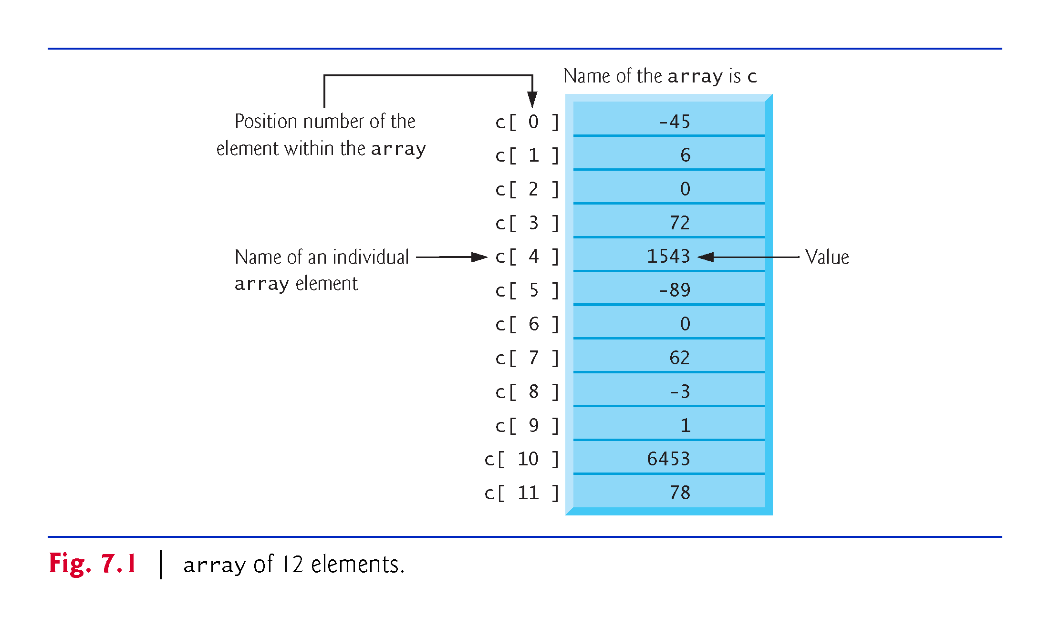

Slide 8
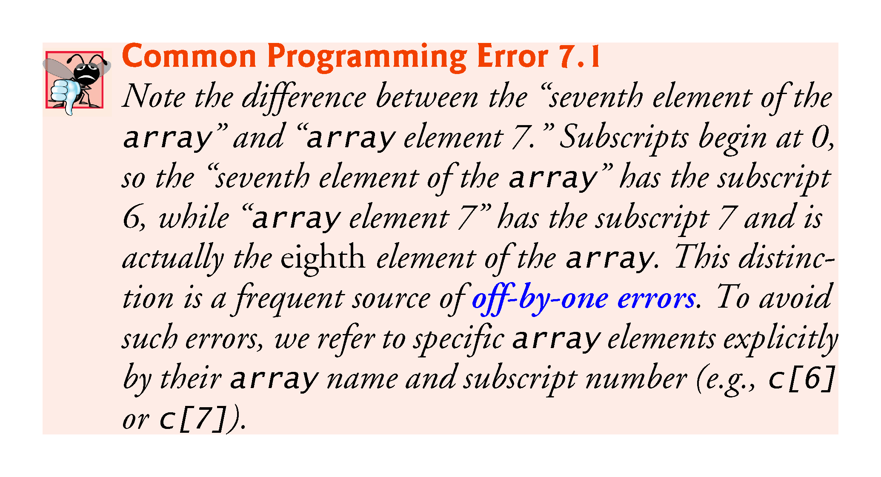

Slide 9
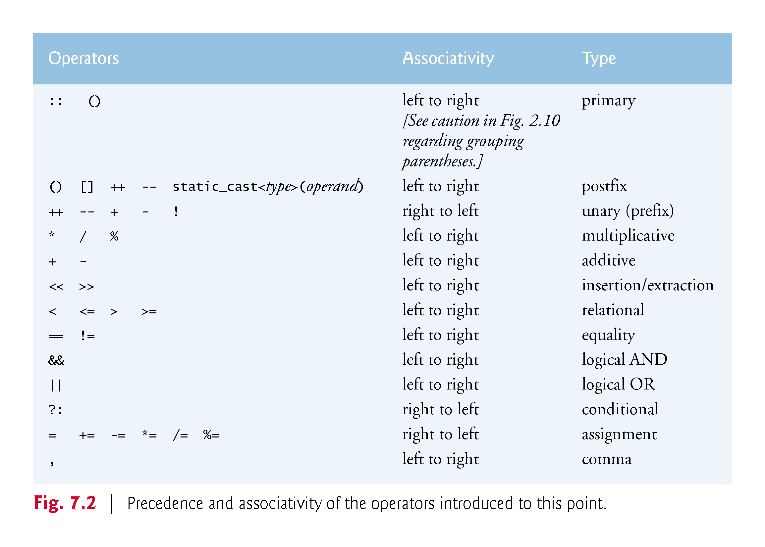

Slide 10
7.3 Declaring arrays
arrays occupy space in memory.
To specify the type of the elements and the number of elements required by an array use a declaration of the form:
array< type, arraySize > arrayName;
The notation <type, arraySize> indicates that array is a class template.
The compiler reserves the appropriate amount of memory based on the type of the elements and the arraySize.
arrays can be declared to contain values of most data types.

Slide 11
7.4 Examples Using arrays
The following examples demonstrate how to declare arrays, how to initialize arrays and how to perform common array manipulations.

Slide 12
7.4.1 Declaring an array and Using a Loop to Initialize the array’s Elements
The program in Fig. 7.3 declares five-element integer array n (line 10).
size_t represents an unsigned integral type.
This type is recommended for any variable that represents an array’s size or an array’s subscripts. Type size_t is defined in the std namespace and is in header <cstddef>, which is included by various other headers.
If you attempt to compile a program that uses type size_t and receive errors indicating that it’s not defined, simply include <cstddef> in your program.

Slide 13
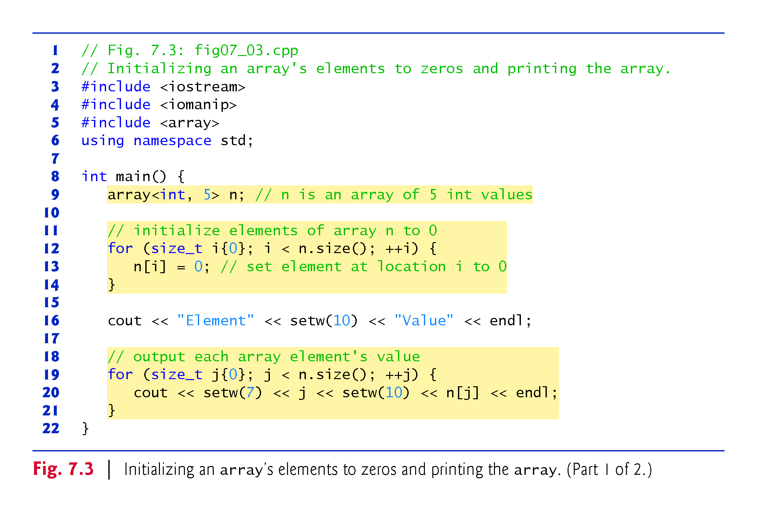

Slide 14
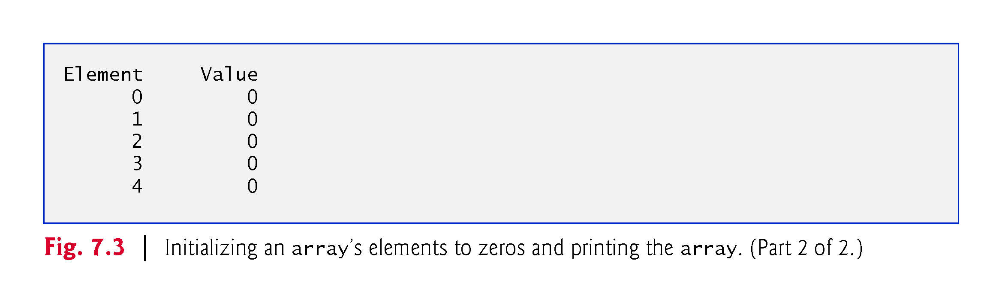

Slide 15
7.4.2 Initializing an array in a Declaration with an Initializer List
The elements of an array also can be initialized in the array declaration by following the array name with an equals sign and a brace-delimited comma-separated list of initializers.
The program in Fig. 7.4 uses an initializer list to initialize an integer array with five values (line 11) and prints the array in tabular format (lines 13–17).
If there are fewer initializers than elements in the array, the remaining array elements are initialized to zero.
If there are more, a compilation error occurs.

Slide 16
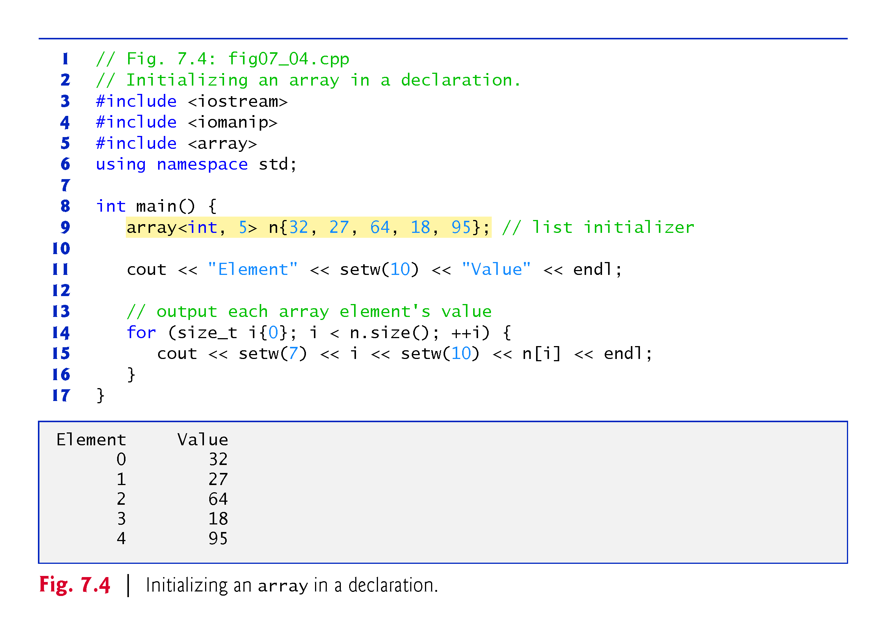

Slide 17
7.4.3 Specifying an array’s Size with a Constant Variable and Setting array Elements with Calculations
Figure 7.5 sets the elements of a 5-element array values to the even integers 2, 4, 6, 8 and 10 and prints the array in tabular format.
Line 10 uses the const qualifier to declare a constant variable arraySize with the value 5.
A constant variable that’s used to specify array’s size must be initialized with a constant expression when it’s declared and cannot be modified thereafter.
Constant variables are also called named constants or read-only variables.

Slide 18
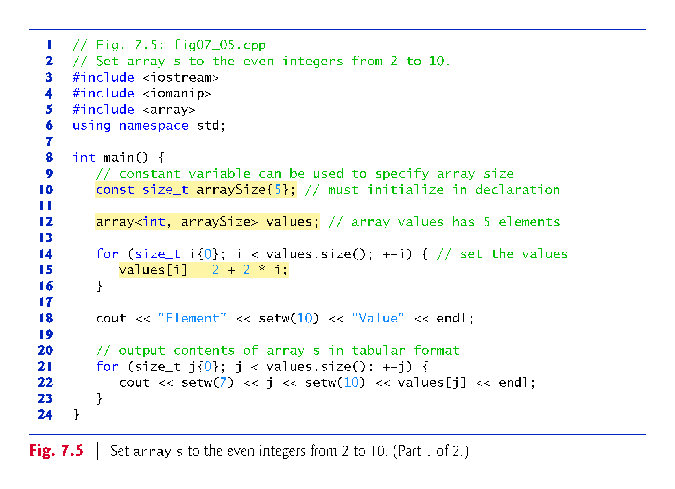

Slide 19
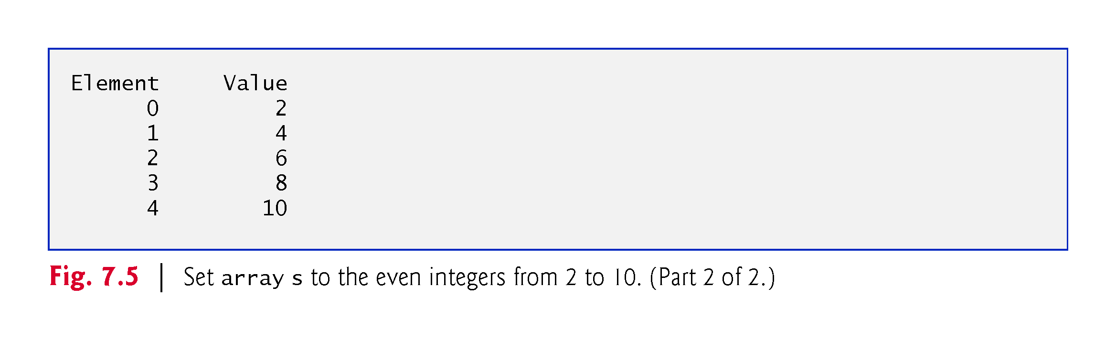

Slide 20
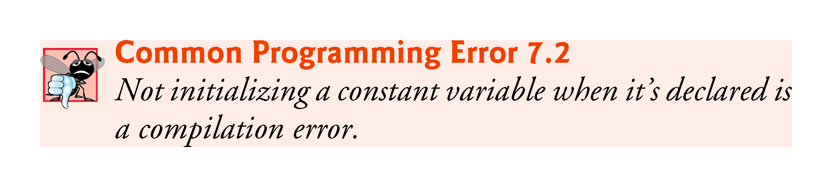

Slide 21
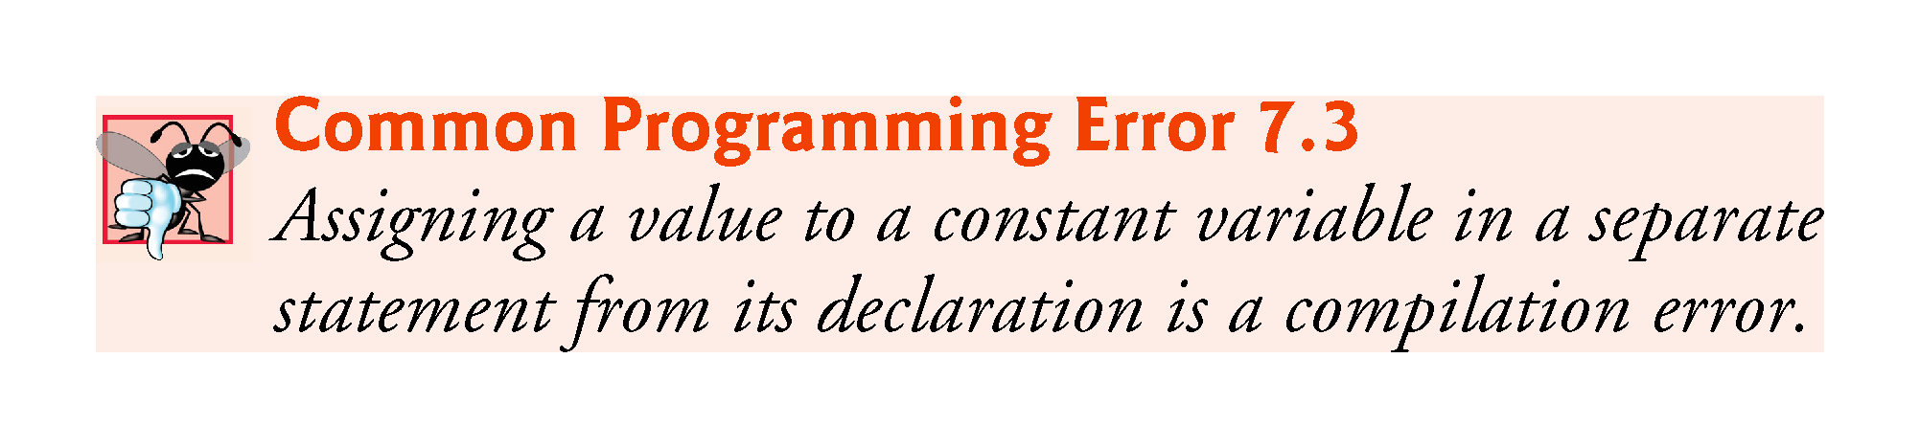

Slide 22
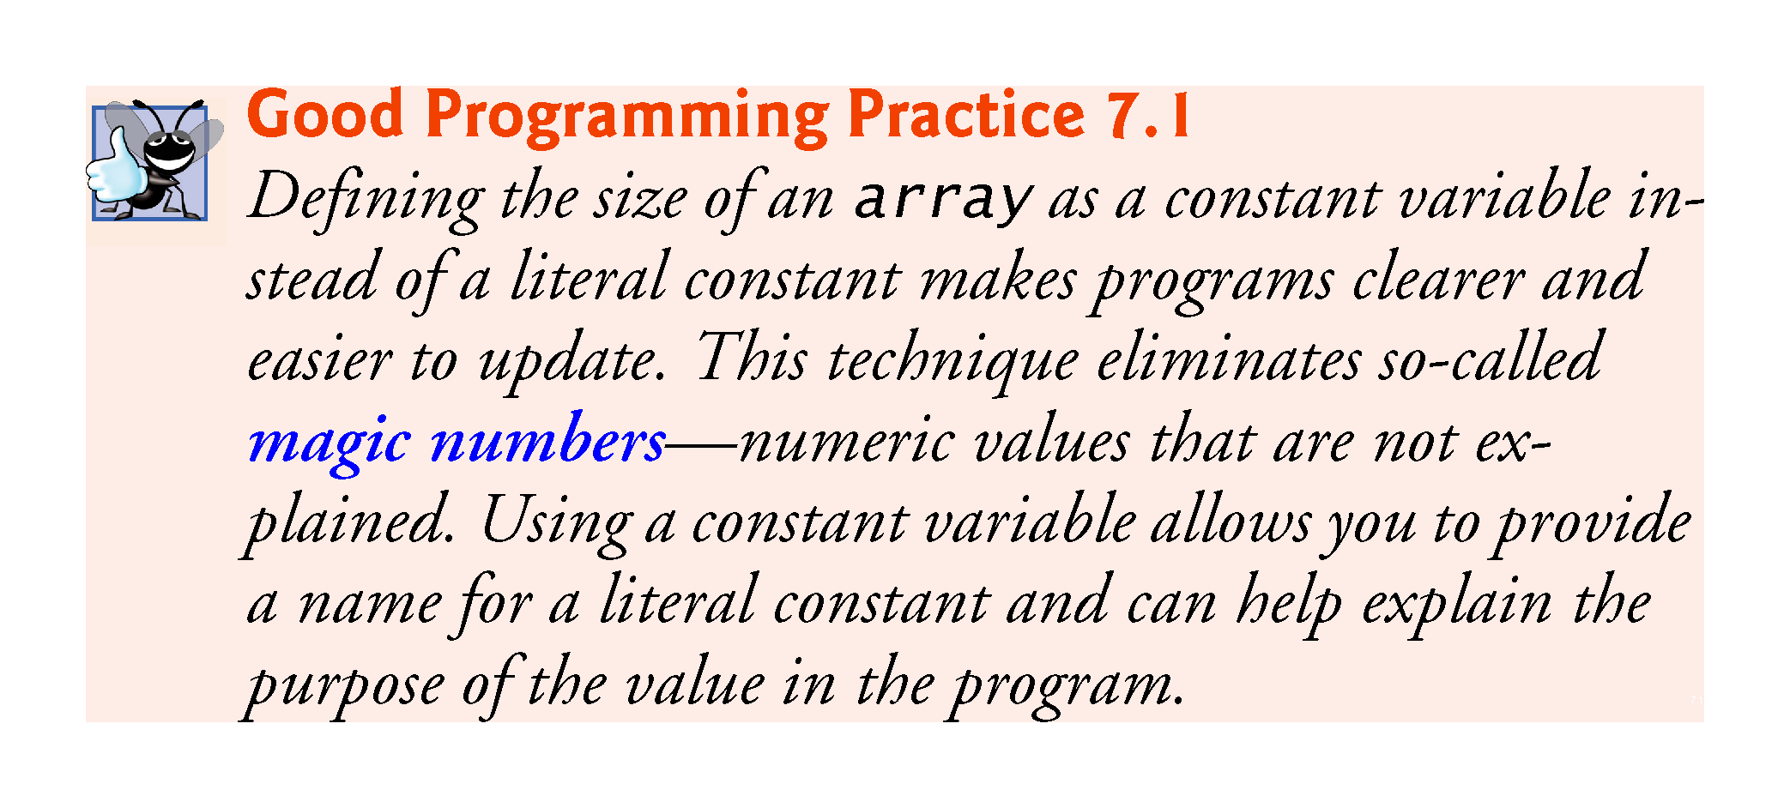

Slide 23
7.4.4 Summing the Elements of an array
Often, the elements of an array represent a series of values to be used in a calculation.
Fig. 7.6 sums the values contained in the four-element integer array a.

Slide 24
Exercises
Declare an array firstArray with 10 elements of type int. Initialize the i^{th} element to i² using a for loop. Remember that the length of the array can be found using firstArray.size(). Then print out the array using another for loop.
Declare an array secondArray with 6 elements of type int and initialize them to whatever you want using a list inside braces. Print out this array also.
Find the sum of the elements of firstArray and secondArray using a for loop.

Slide 25
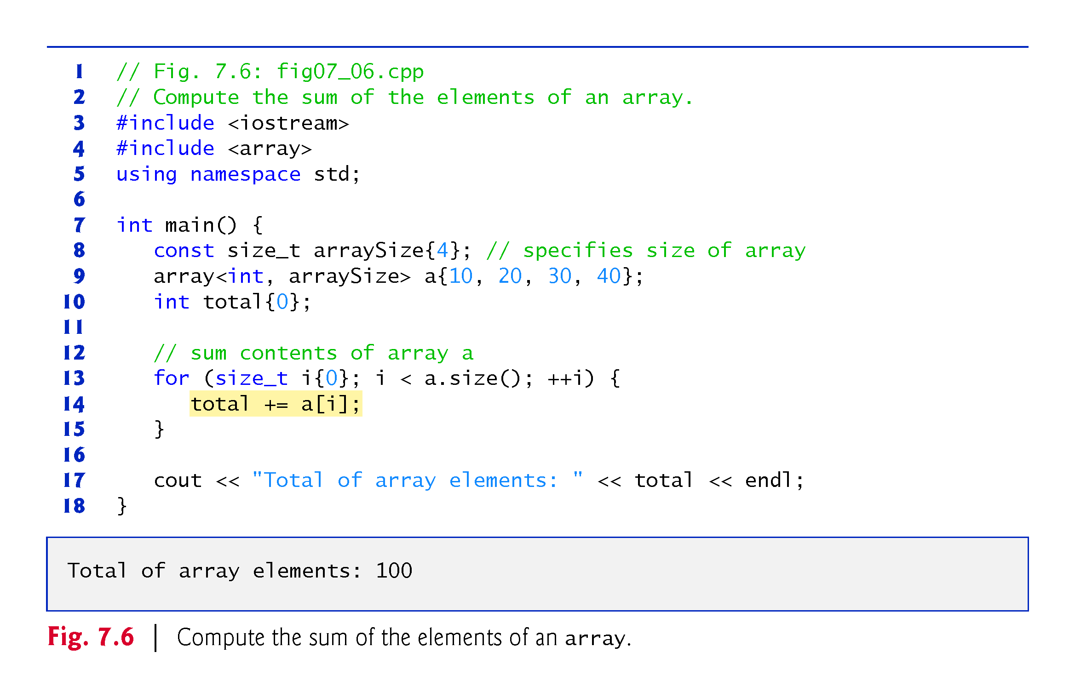

Slide 26
7.4.5 Using Bar Charts to Display array Data Graphically
Many programs present data to users graphically.
One simple way to display numeric data graphically is with a bar chart that shows each numeric value as a bar of asterisks (*).
Fig. 7.7 stores data in an array of 11 elements, each corresponding to a grade category.

Slide 27
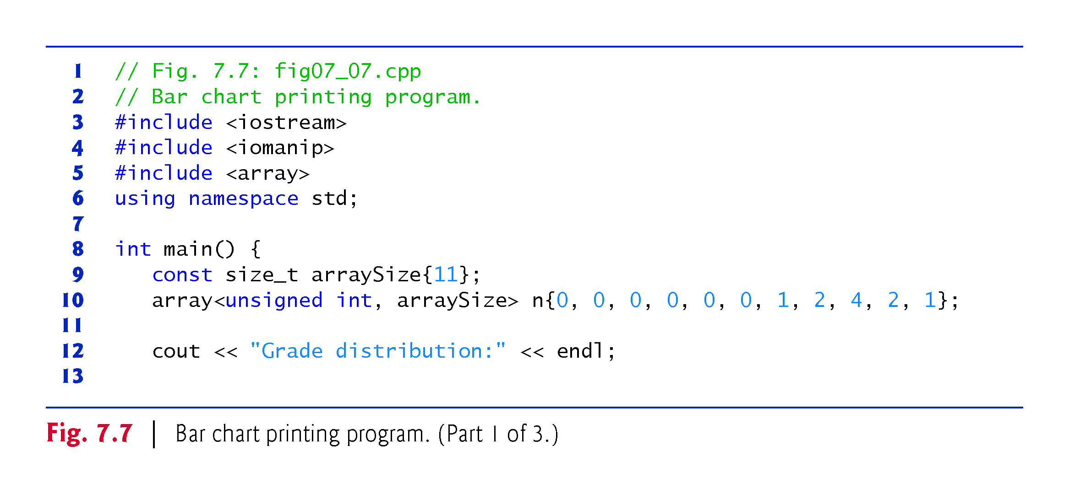

Slide 28
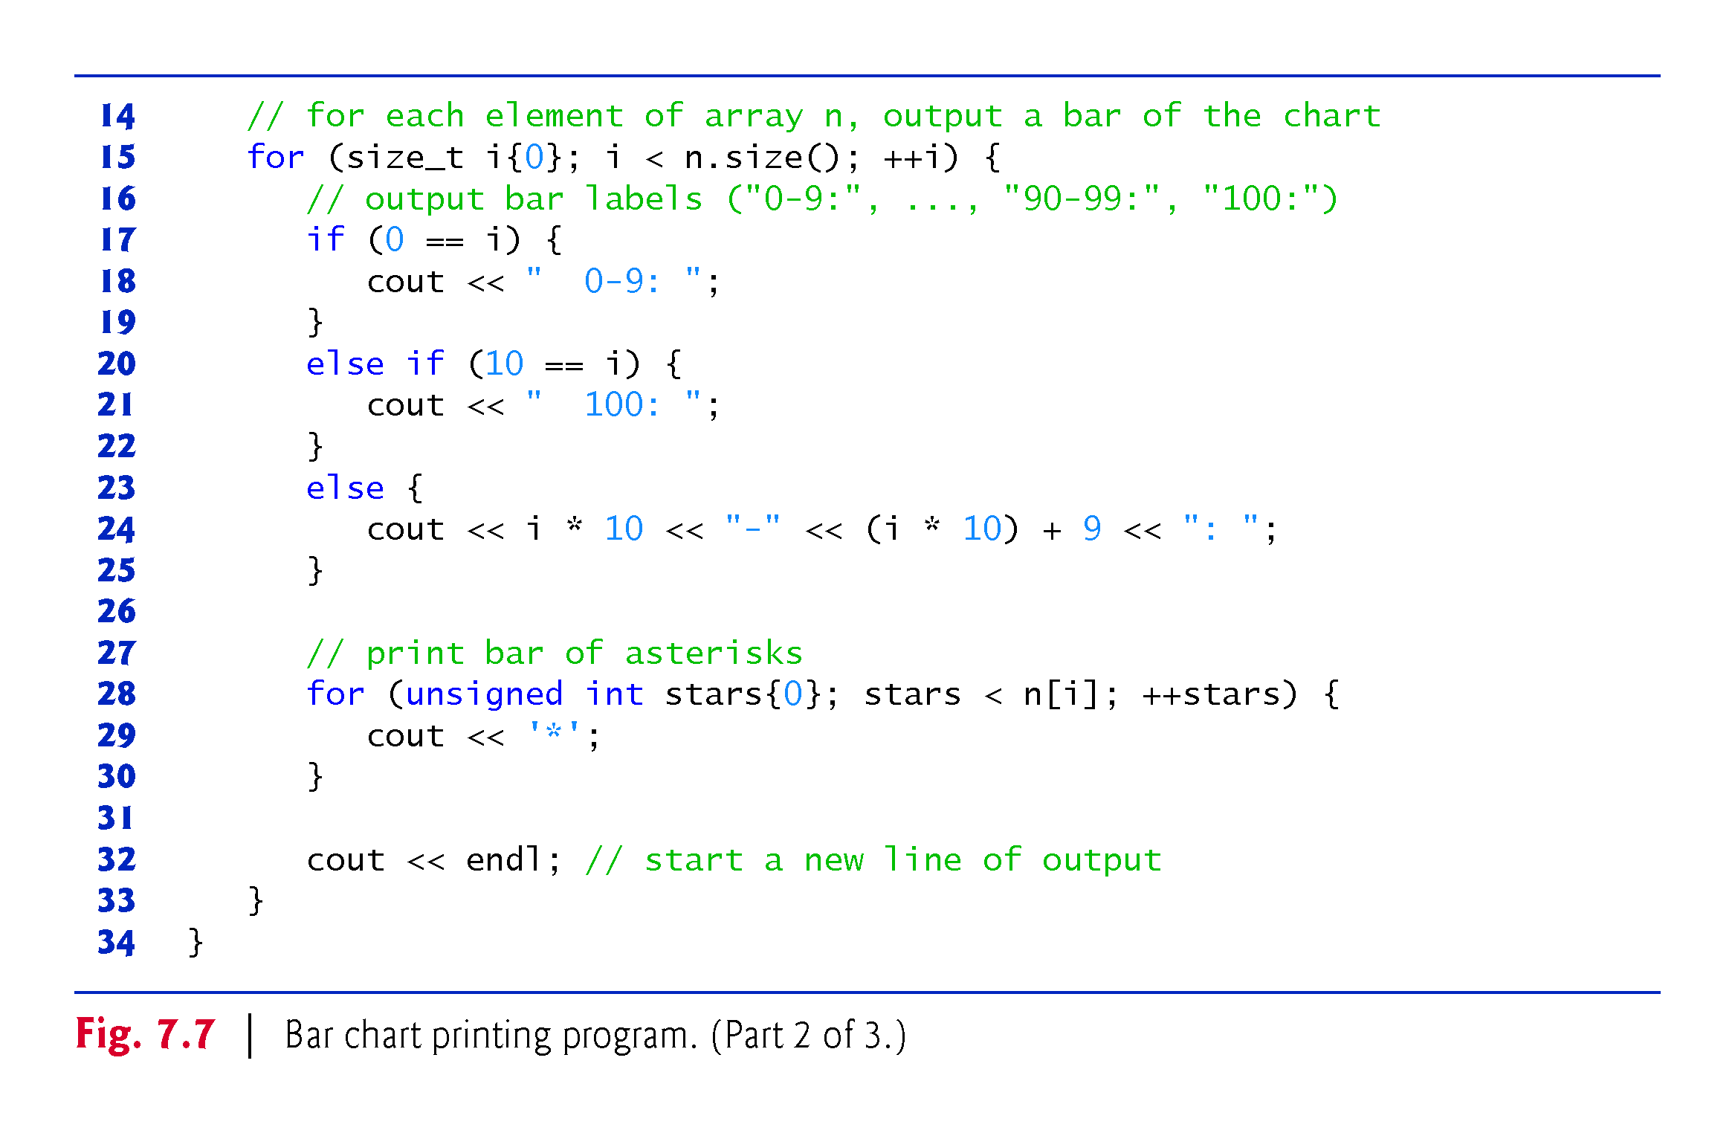

Slide 29
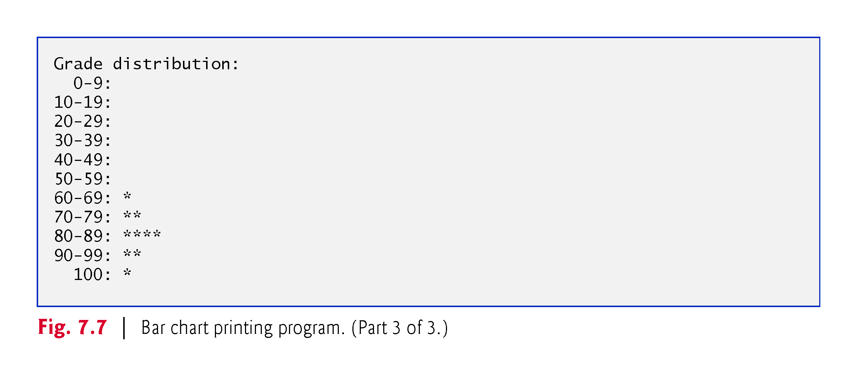

Slide 30
7.4.6 Using the Elements of an array as Counters
Sometimes, programs use counter variables to summarize data, such as the results of a survey.
In Fig. 6.9, we used separate counters in our die-rolling program to track the number of occurrences of each side of a die as the program rolled the die 60,000,000 times.
An array version of this program is shown in Fig. 7.8.
This version also uses the new C++11 random-number generation capabilities that were introduced in Section 6.9.
The single statement in line 21 of this program replaces the switch statement in Fig. 6.9.

Slide 31
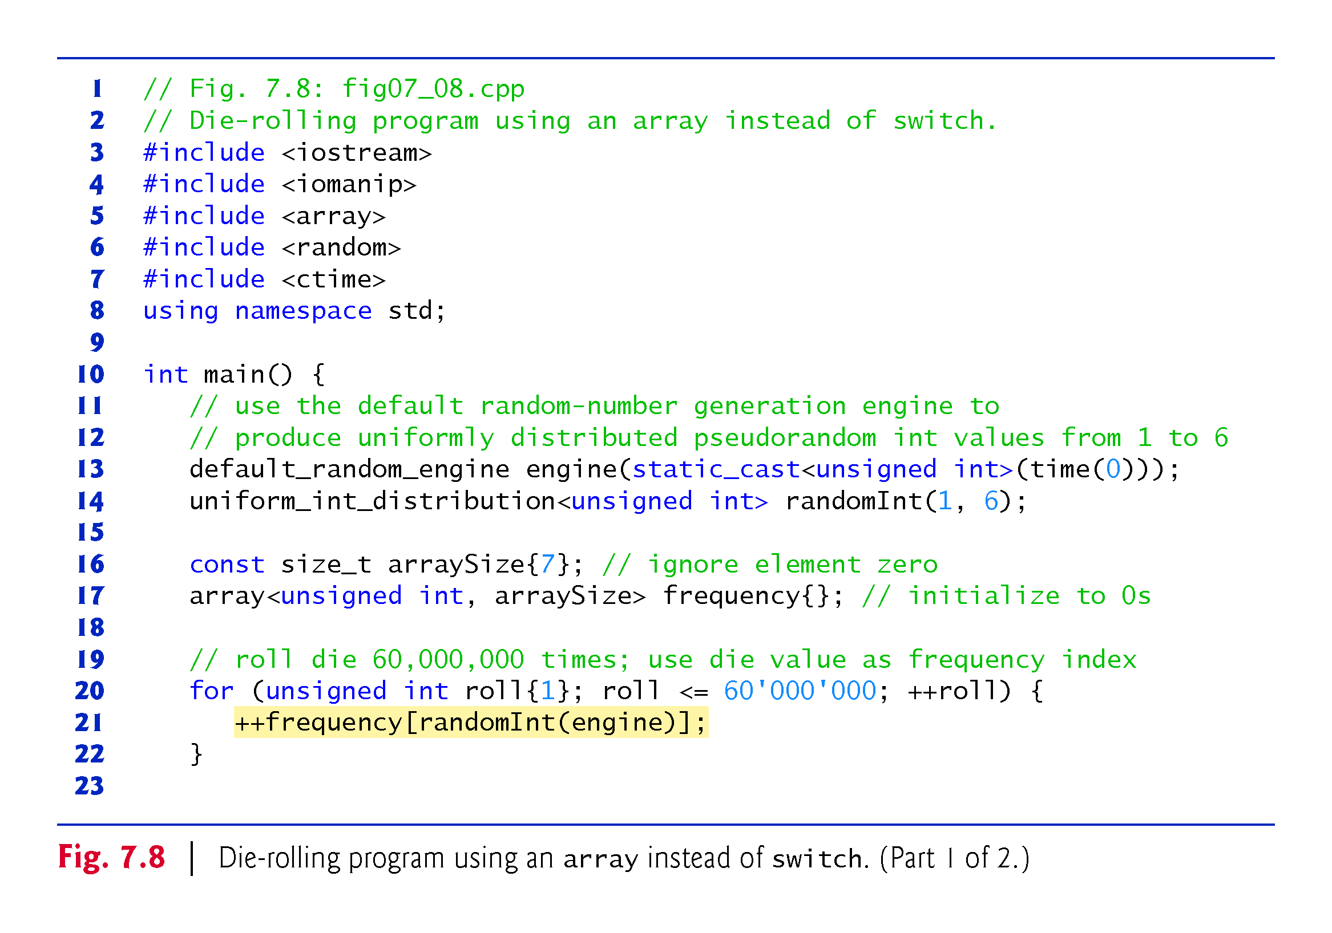

Slide 32
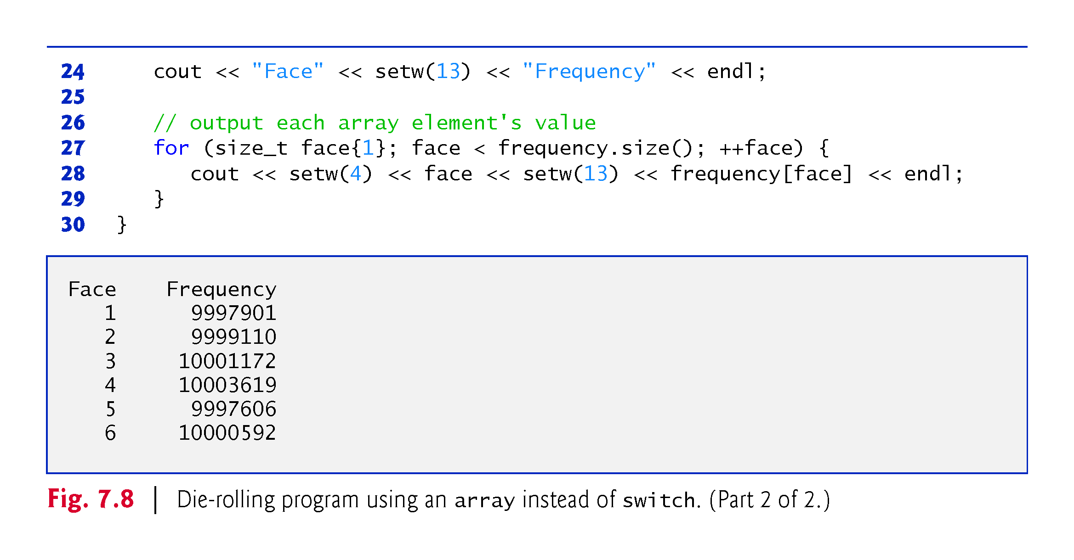

Slide 33
7.4.7 Using arrays to Summarize Survey Results
Fig. 7.9 uses arrays to summarize the results of data collected in a survey.
Consider the following problem statement:
Twenty students were asked to rate on a scale of 1 to 5 the quality of the food in the student cafeteria, with 1 being “awful” and 5 being “excellent.” Place the 20 responses in an integer array and determine the frequency of each rating.
C++ provides no automatic array bounds checking to prevent you from referring to an element that does not exist.
Thus, an executing program can “walk off” either end of an array without warning.
Class templates array and vector each have an at function that performs bounds checking for you.

Slide 34
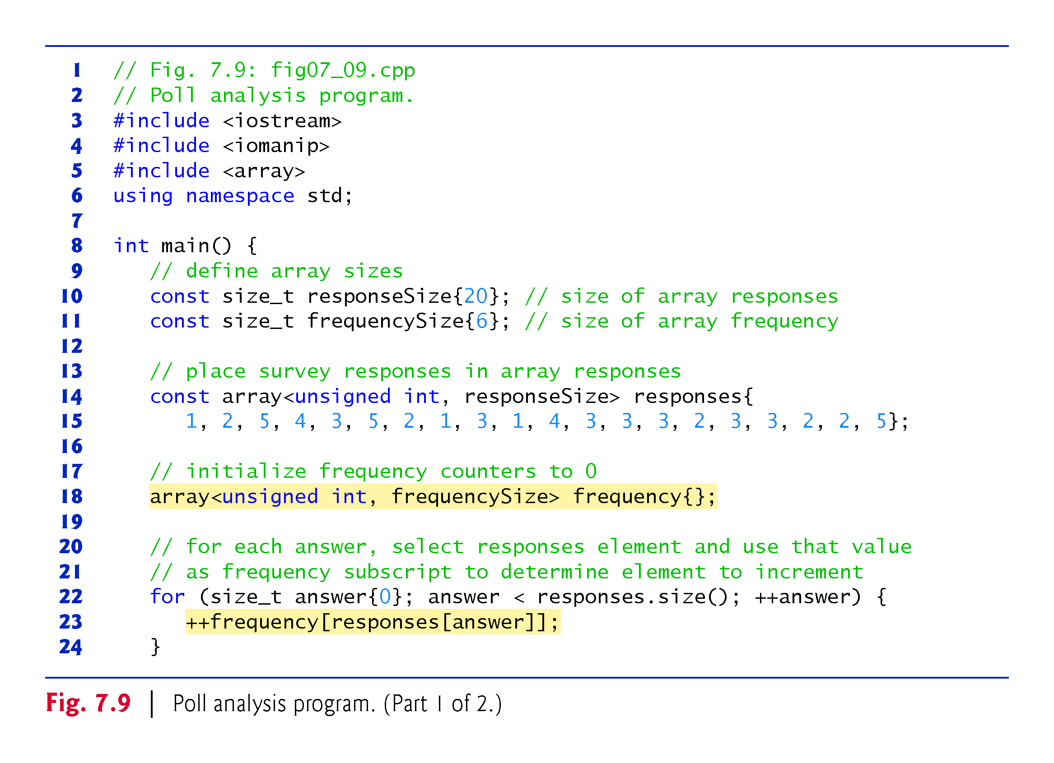

Slide 35
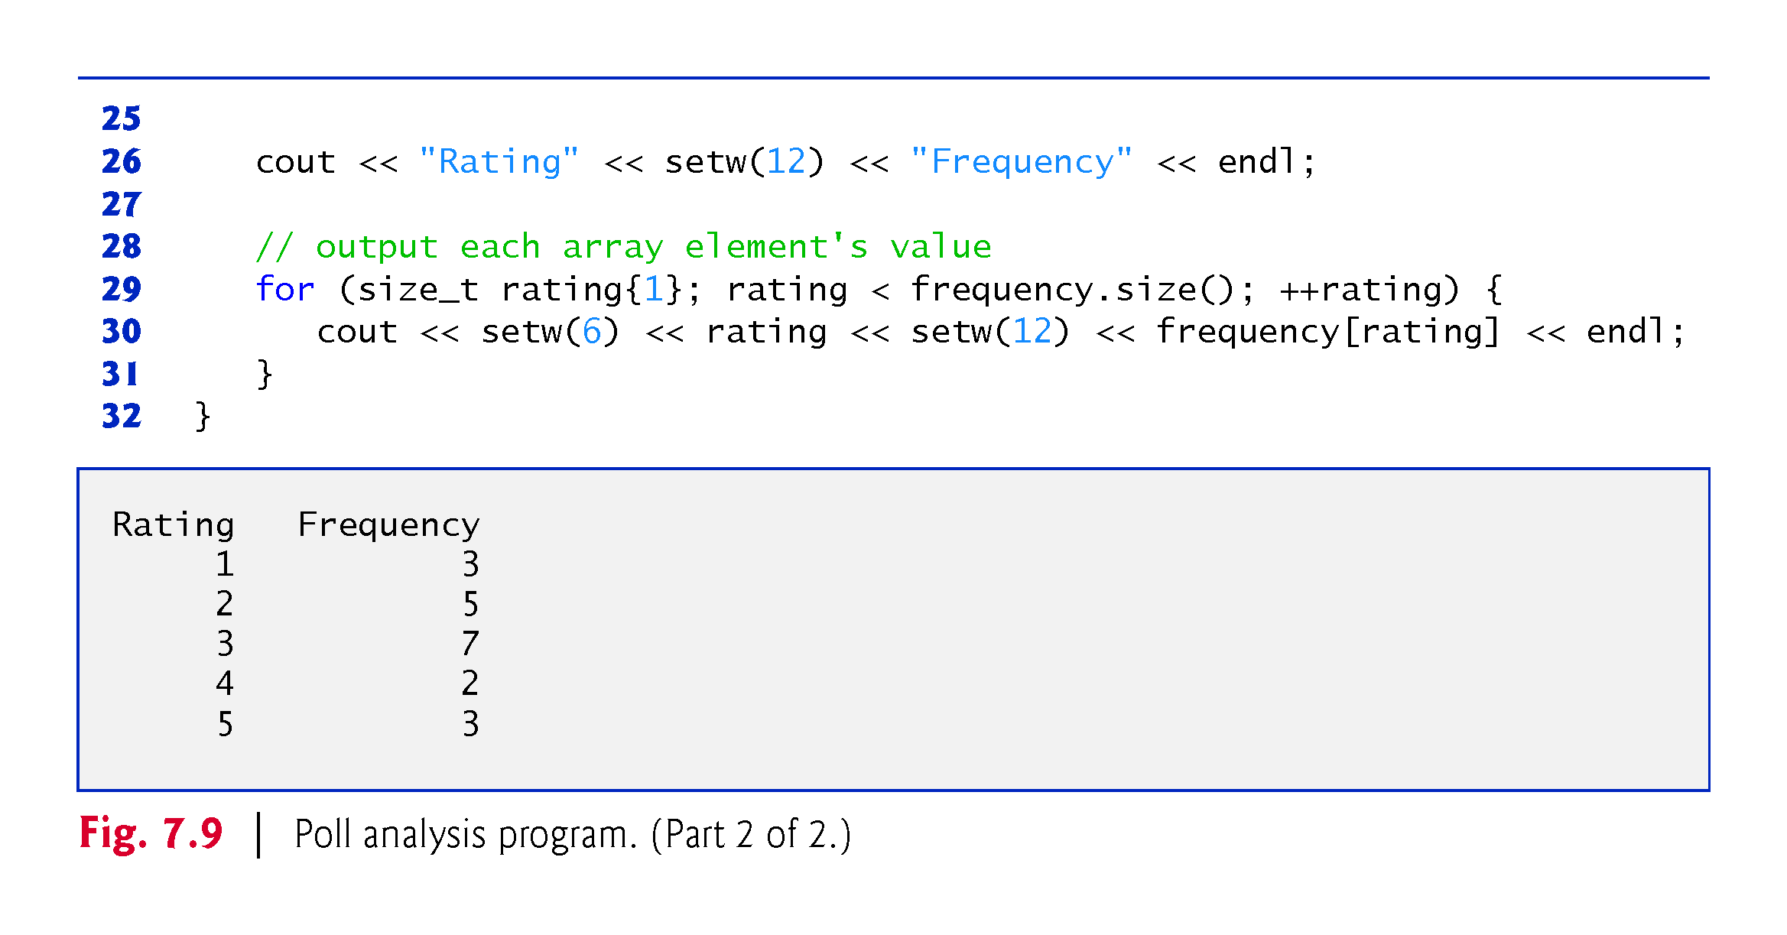

Slide 36
7.4.7 Using arrays to Summarize Survey Results
It’s important to ensure that every subscript you use to access an array element is within the array’s bounds—that is, greater than or equal to 0 and less than the number of array elements.
Allowing programs to read from or write to array elements outside the bounds of arrays are common security flaws.
Reading from out-of-bounds array elements can cause a program to crash or even appear to execute correctly while using bad data.
Writing to an out-of-bounds element (known as a buffer overflow) can corrupt a program’s data in memory, crash a program and allow attackers to exploit the system and execute their own code.

Slide 37
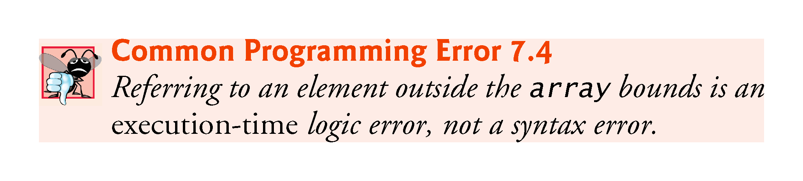

Slide 38
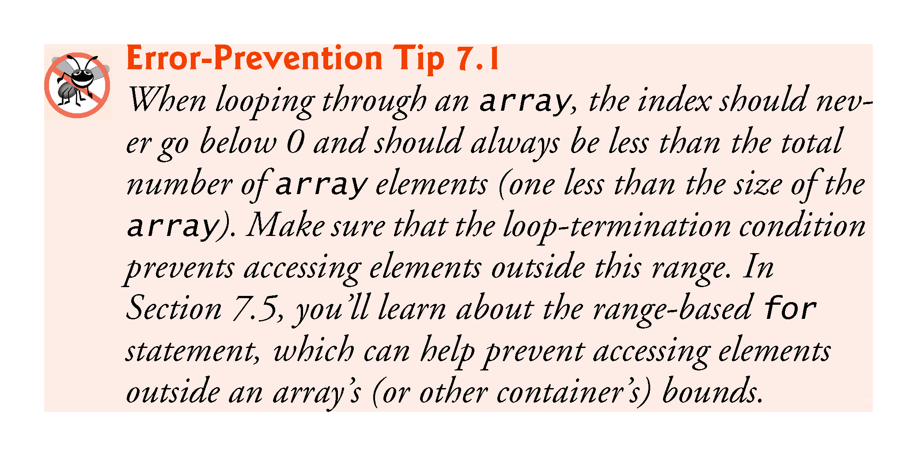

Slide 39
Exercise
In your previous program, make the for loop that prints out firstArray to run from 0 to 10 (instead of 0 to 9). What happens?
Define an array thirdOne and initialize it using rand()%11 (that is, random numbers between 0 and 10). Then define another array results of type int and size 11 that will summarize the results (results[0] will be how many 0’s, results[1] how many 1’s, etc).

Slide 40
7.4.8 Static Local arrays and Automatic Local arrays
A program initializes static local arrays when their declarations are first encountered.
If a static array is not initialized explicitly by you, each element of that array is initialized to zero by the compiler when the array is created.

Slide 41
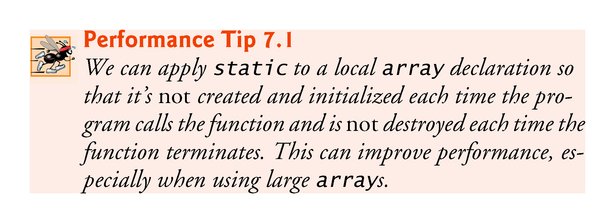

Slide 42
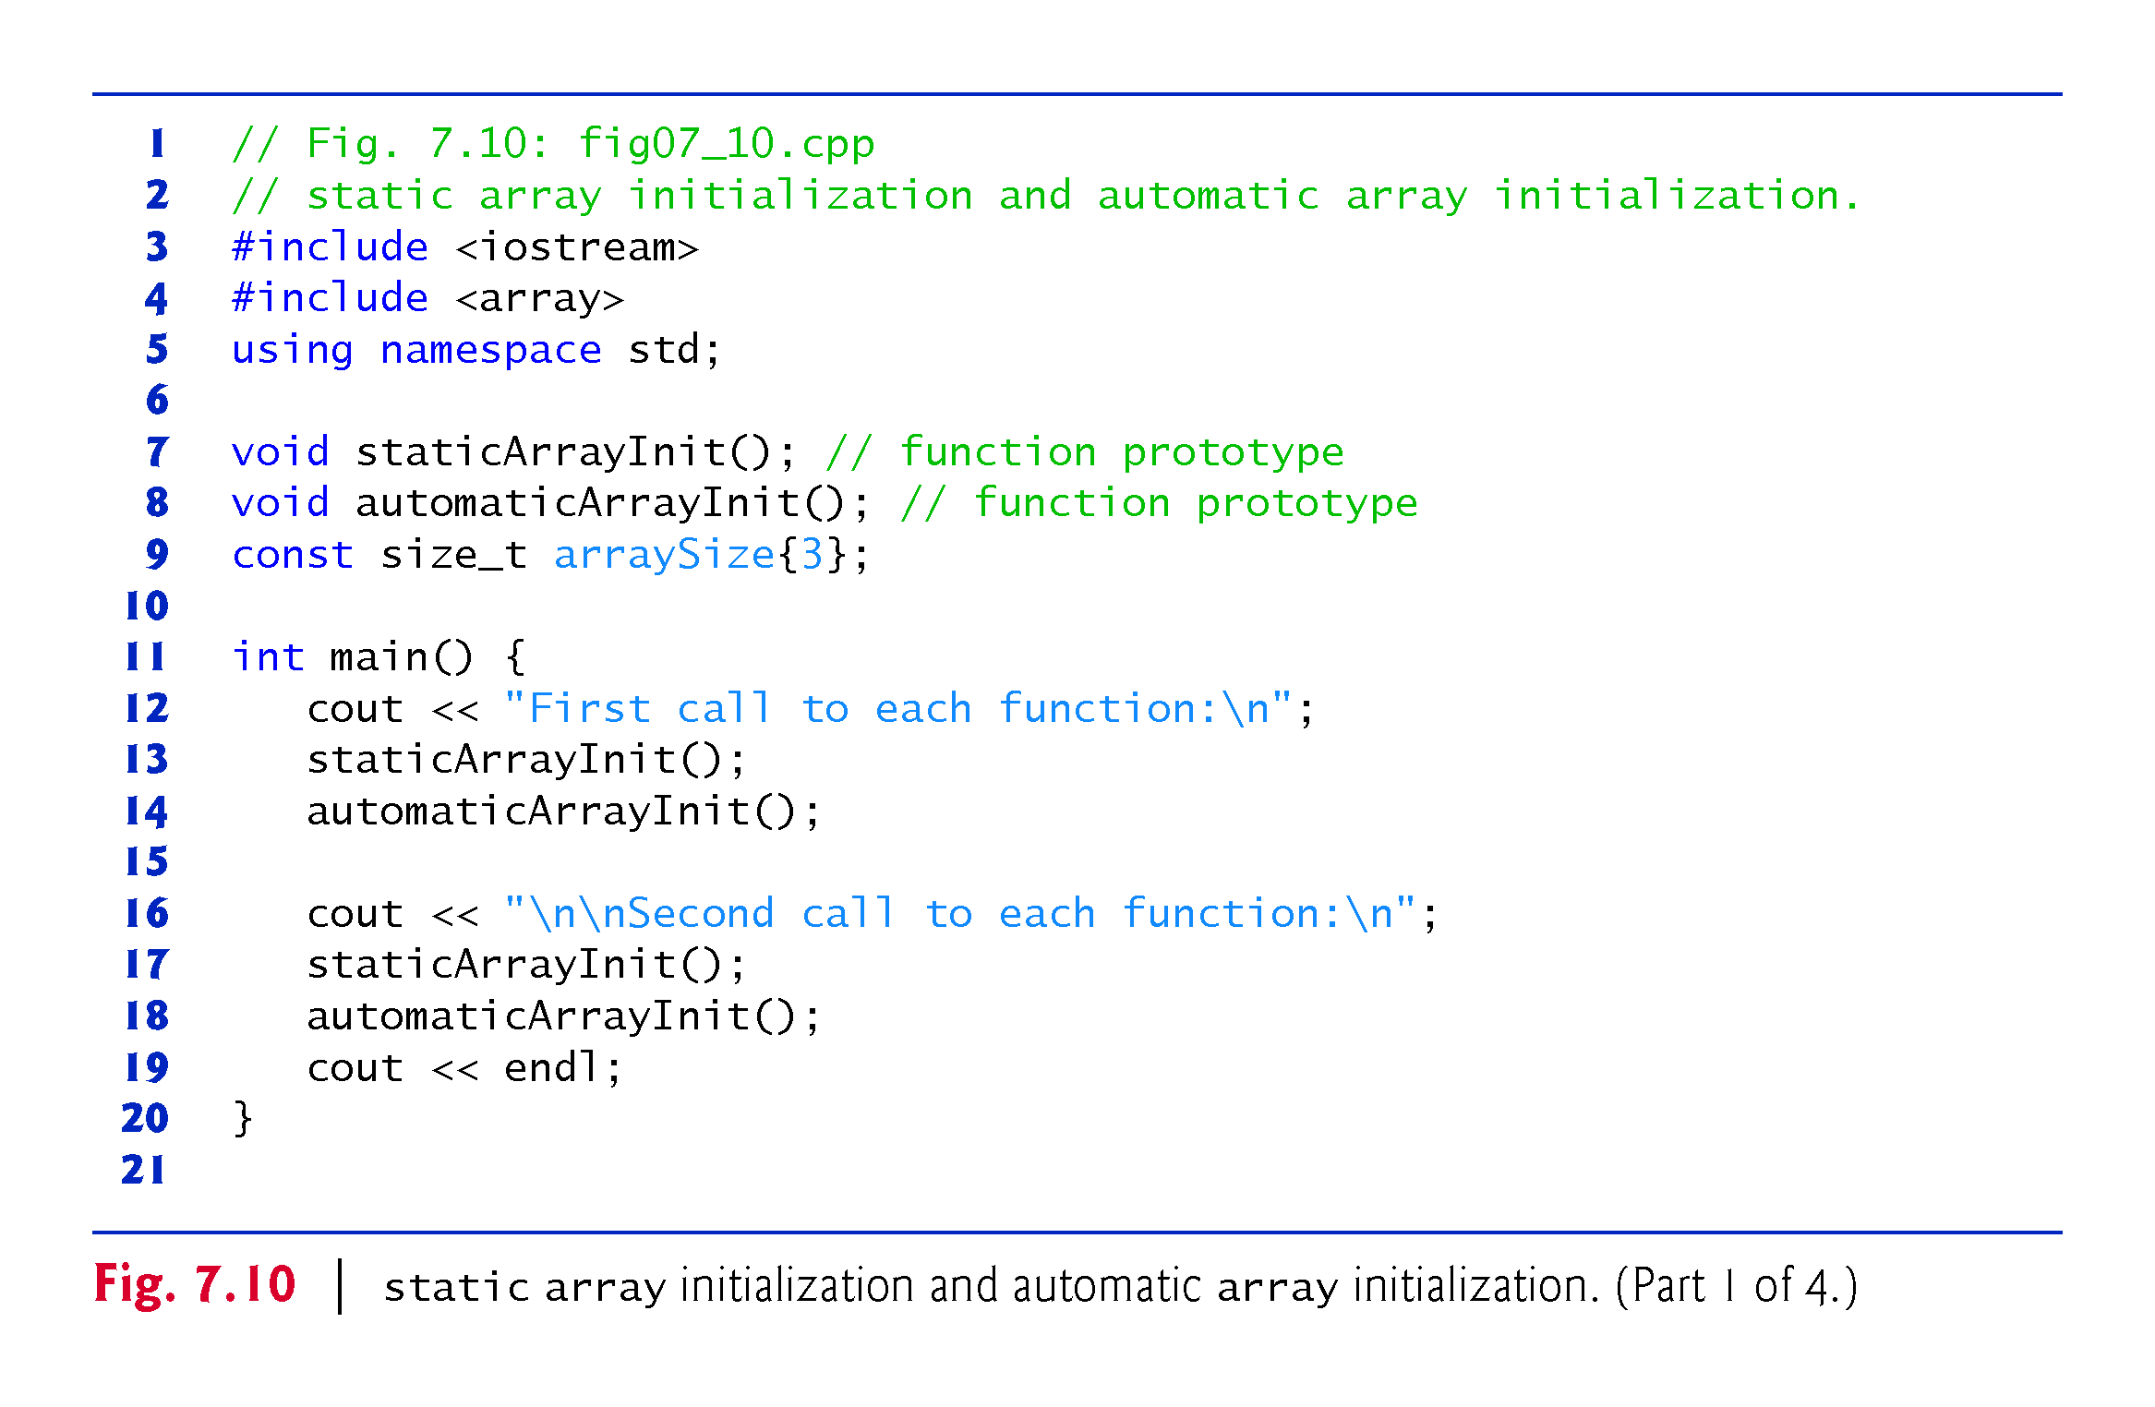

Slide 43
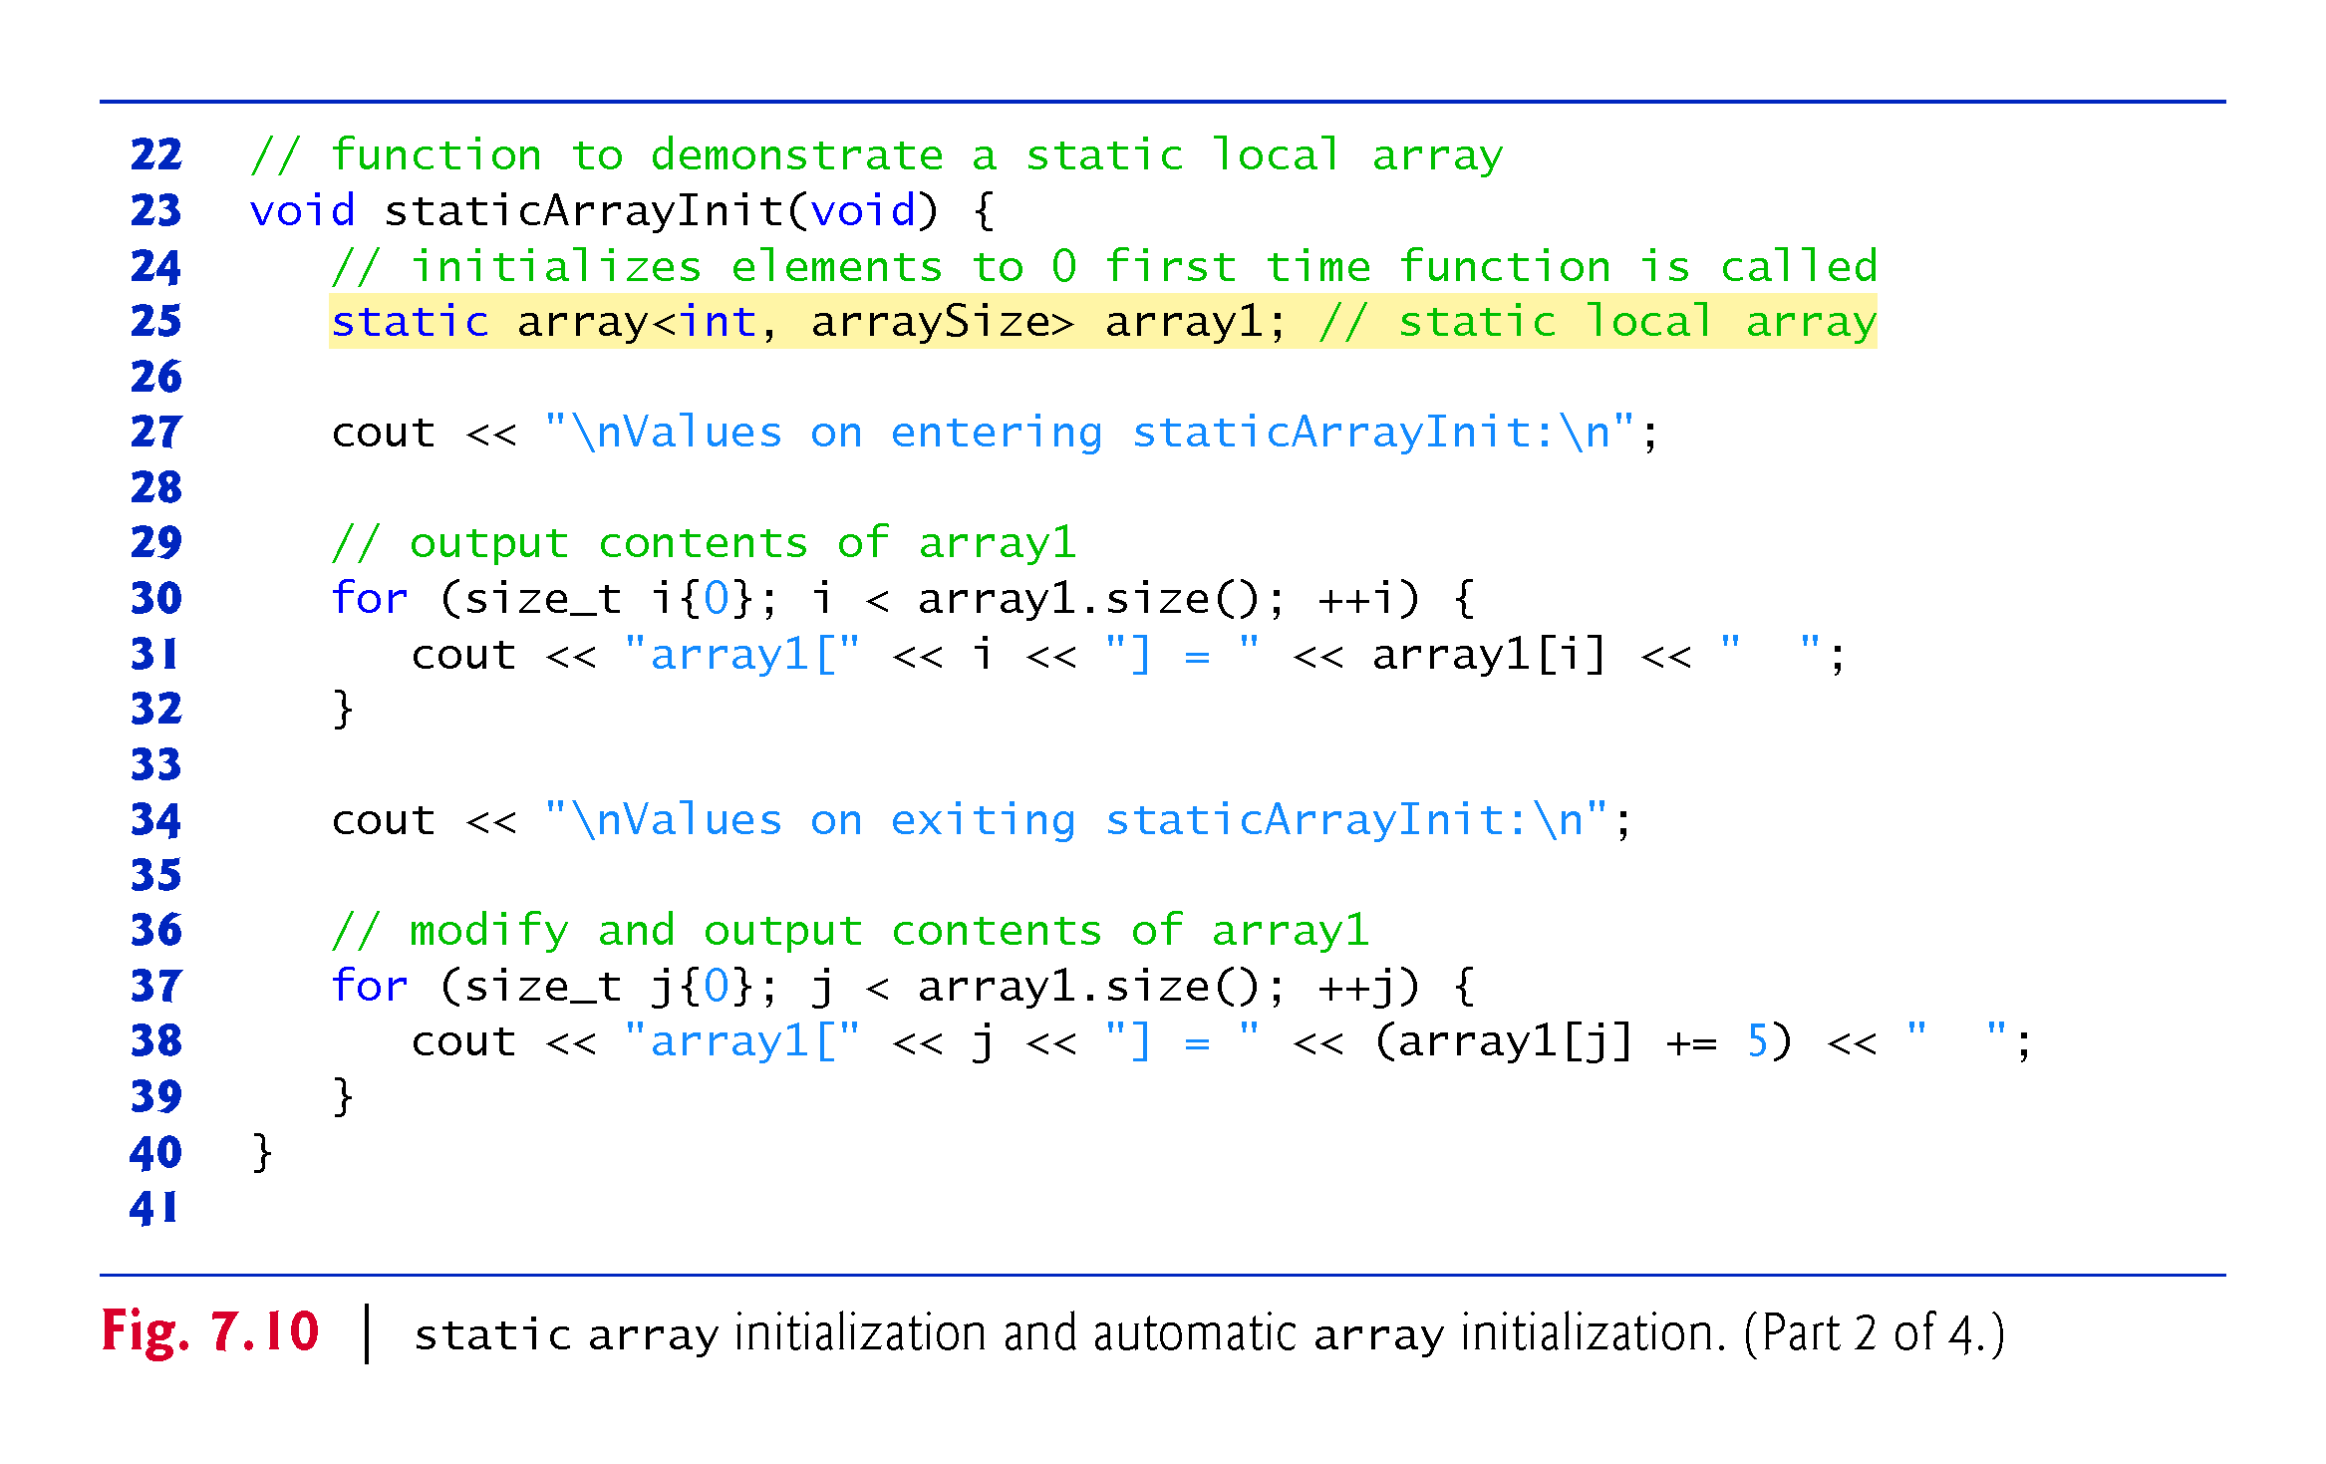

Slide 44
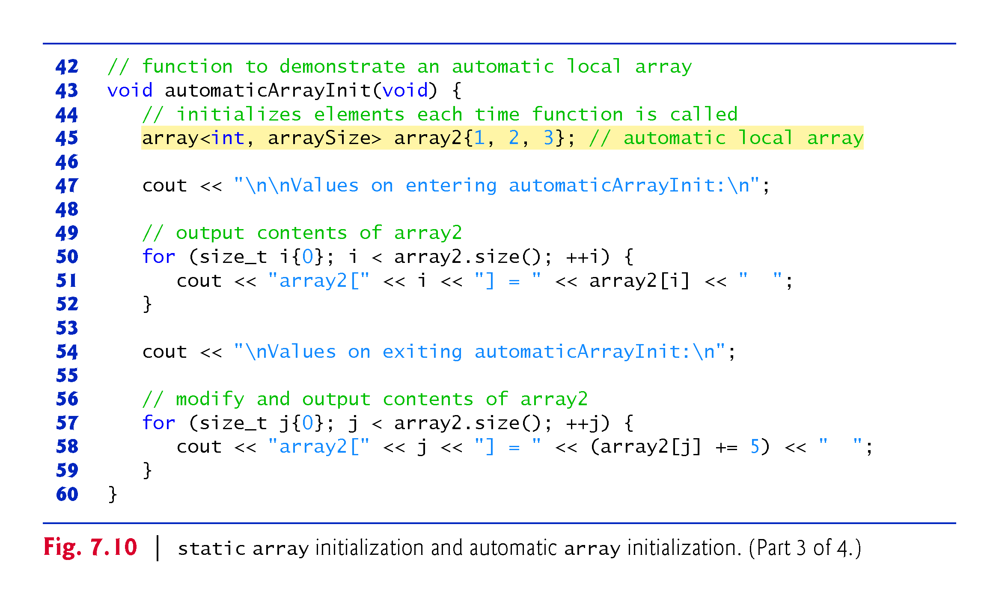

Slide 45
